Slide 1
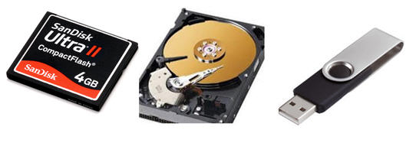
ADVANCEMENTS IN PHYSICAL STORAGE DEVICES
Apphia Benjamin
Maria Cox
Joshua Dookie
Joanna Joseph
Victoria Nanan
Nataki Medina
Uddesh Sahadeo

Slide 2
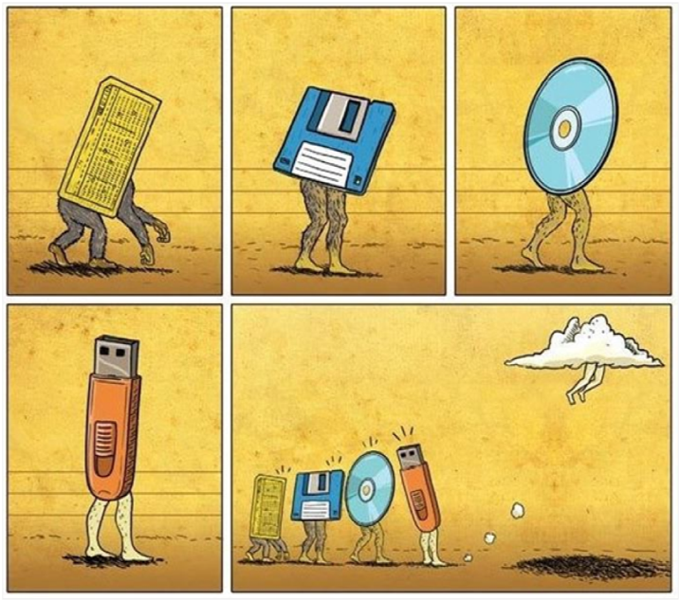
What is a Storage Device?
any computing hardware that is used for storing, porting and extracting data files and objects

Slide 3
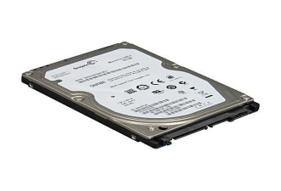
HARD DISK DRIVE
FLASH DRIVE
A hard disk dive uses magnetic disks for storing software and data in files
The disks spin at high speeds while drive heads read and write data.
It is used for storage of operating system
Advantage-can store huge amounts of data
Disadvantage- can be damaged easily
Referred to as Solid State Drives (SSD)
Data access- Direct access
More expensive than most forms of storage
Has a capacity of 2GB upwards.
It has a speed slower than an internal hard disk, faster than other forms of storage.
They are portable, reliable and durable.

Slide 4
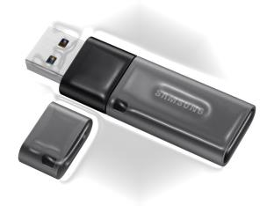
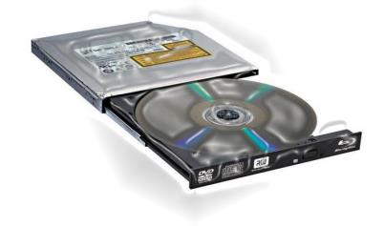
USB FLASH DRIVES
CD & DVD DRIVES
A small data storage device that plugs into a computer USB port.
Are more rugged and less prone to data loss than hard drives.
They are smaller, faster, and they carrying capacity size is over a thousands times more than its predecessors.
USB flash drives usually range from two gigabytes to over 250 gigabytes and come in a variety of styles, shapes and colors.
Referred to as optical storage devices.
Optical storage is still stuck in the gigabytes while most hard drives are pushing even more terabytes.
Used to store movies and music.
Finding a PC that includes any sort of optical drive is becoming very difficult.
Capacity has not matched other markets.

Slide 5
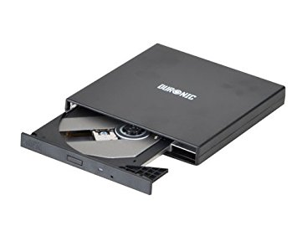
CD-ROM
This stands for Compact Disc Read Only Memory
It records data on the surface of flat plastic discs in microscopic indentations called pits by laser light.
This is permanent data which means it cannot be changed.
It is cost effective and can hold up to 700MB
Stores computer data in the form of text and graphics

Slide 6
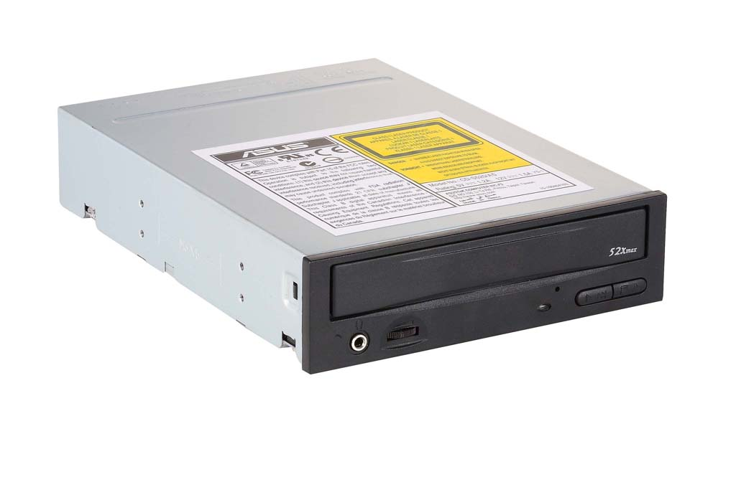
CD-RW DRIVES
This is a modified version of CDs.
It stands for Compact Disc-Rewritable Drives.
In this case data can now be changed, altered and erased.
More costly than CD-ROM
Also known as burners and provide full read/write capabilities.
Storage capacity has increased to 650MB
Able to read all major types of digital media

Slide 7
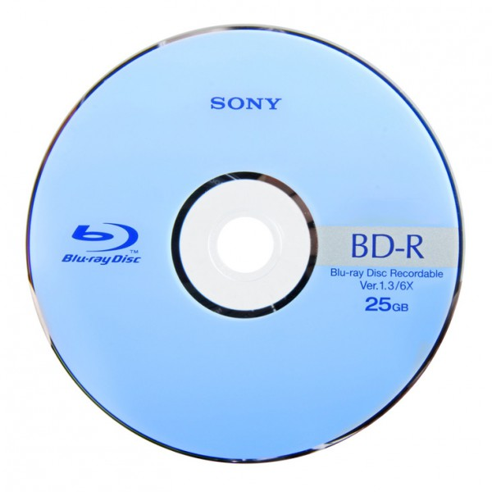
BLU-RAY DISC
Again as time goes by and technology is being evolved, from CD-ROM to CD-RW we now have BLU-RAY DISCS.
This is the latest form of optical storage devices. It got its name from the blue violet rays used to read and write the data.
It can hold a large amount of data and has 5 times the storage of a DVD.
Its an optical storage that can store high definition of up to 1080p.
It stores digitally encoded data in spiralled groves on a polycarbonate layer.

Slide 8
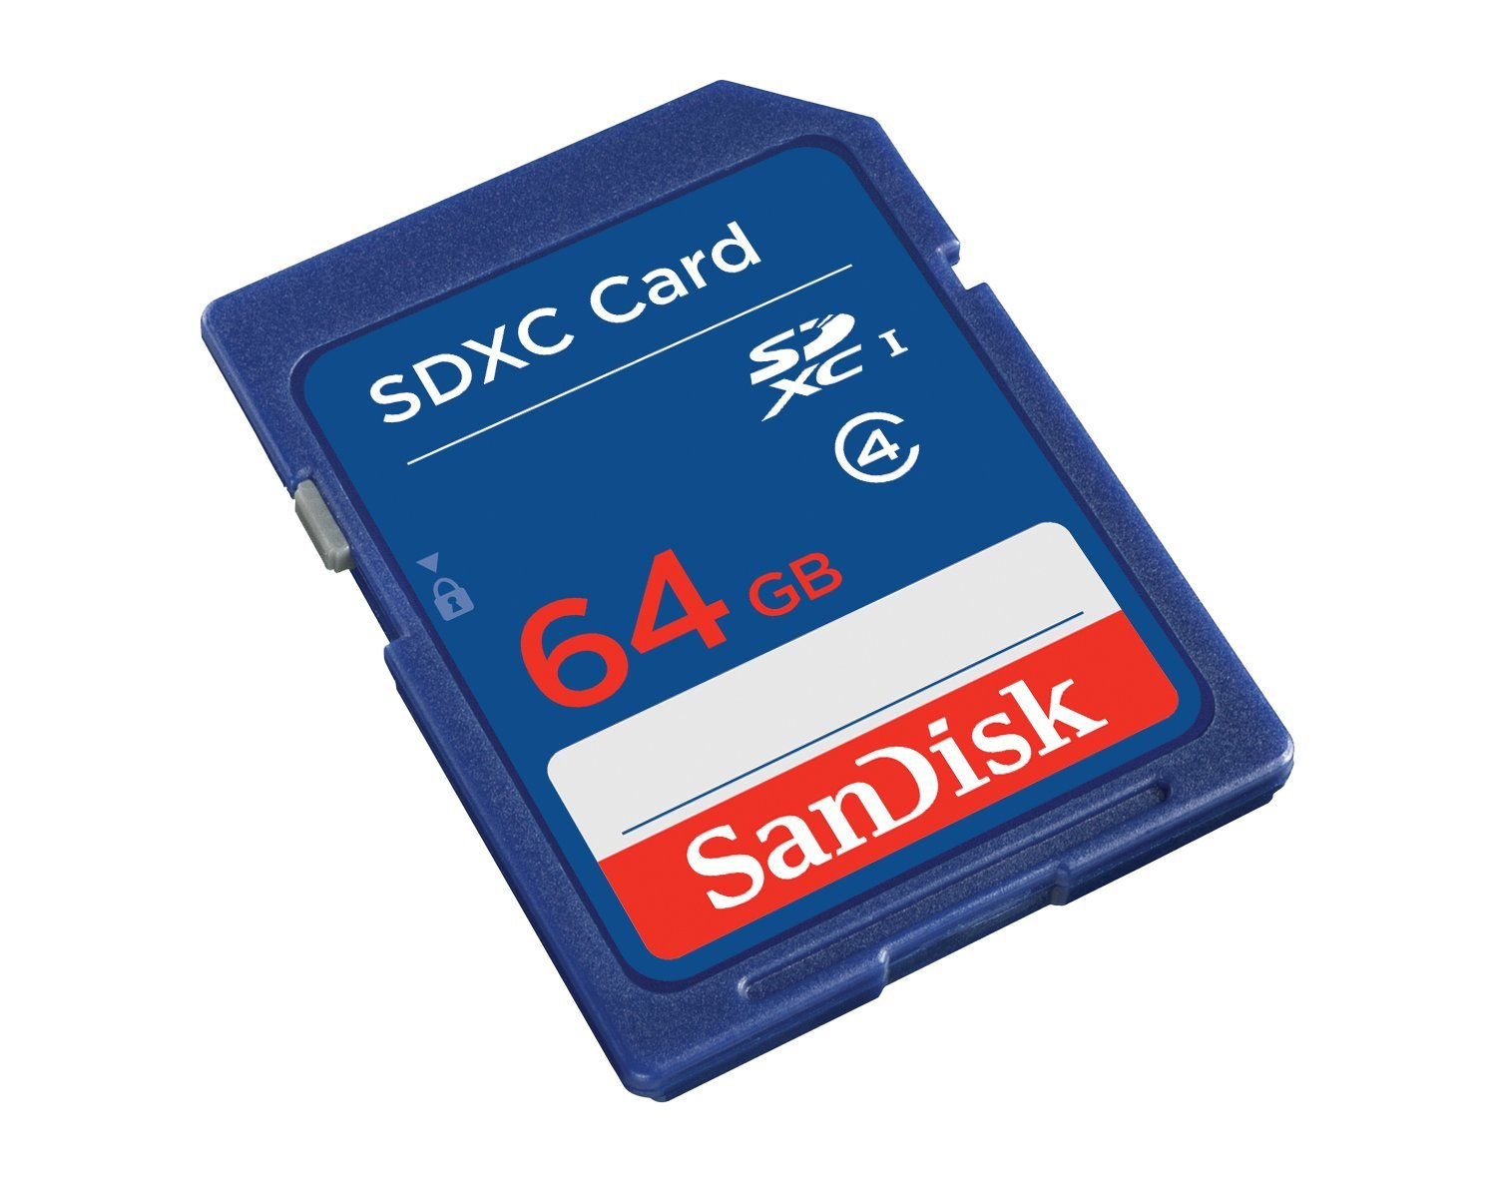
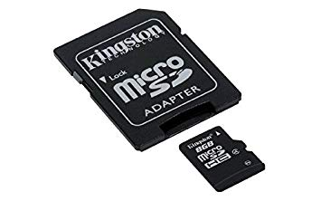
FLASH MEMORY CARDS
This is also known as storage cards.
It is used to store data on a potable or remote computing device/devices.
Such data includes text, video and pictures.

Slide 9
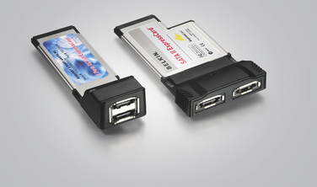
EXPRESS CARDS
Supports several hosts
Has a lot more bandwidth because of its direct connection to the system bus.
It’s a printed circuit board that uses slots to enable a computer system with additional features.
It has a maximum of 2.5GB

Slide 10
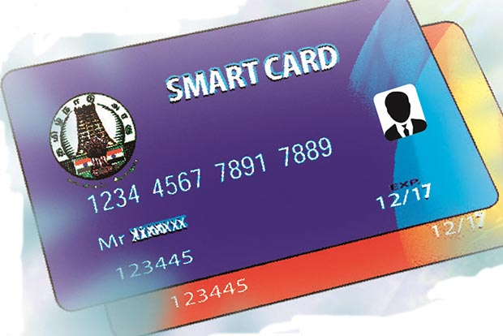
Smart Cards
A smart card is a card that stores information on a microprocessor or memory chip rather than the magnetic stripe found on ATM and credit cards.
Smart cards are read either by physical slots or short-range Wi-Fi via near field communication.
The cards are used for transferring financial information along with a variety of identification purposes.
Some companies use smart cards as identification cards for added security. Transactions made with smart cards are encrypted and cannot be hacked.

Slide 11
Developing Technological Advancements in Physical Storage Devices
Holographic Storage: this type of storage seeks to combine two laser beams to create a pattern on photosensitive media resulting in a three-dimensional (3D) image. It is being enabled with much higher density storage and archival capabilities. The goal with this development it to store terabytes of data on a very flat surface – no thicker than the width of several CD’s.
Wireless Memory Cards: This memory card uses all the features of a typical flash memory card but combines them with wireless circuitry. This enables the card to be wirelessly connected to a PC which allows for easy transfer of storage such as pictures. Digital photography currently utilizes this technology but more uses are being developed.
Racetrack Memory: Racetrack memory tends to eliminate the use of physical hard drives and flash memory completely as they are a reduced size with more space. This new technology is currently being developed to use the spin of electrons to store information. Transferring and receiving would be done at much higher rates with the storage capability of 10,000x more than today’s hard drive and flash memory.

